Slide 1
APARNA S
711721104016
Final Project
3/21/2024 Annual Review

Slide 2
PROJECT TITLE
Traffic sign recognition using CNN
And Keras
3/21/2024 Annual Review

Slide 3


AGENDA
Problem Statement
Project Overview
End Users
Our solution and Value Proposition
Key Features
Modelling Approach
Results and Evaluation
3/21/2024 Annual Review

Slide 4

PROBLEM STATEMENT
Develop a robust Convolutional Neural Network (CNN) model using the Keras deep learning framework to accurately classify traffic signs from input images.
3/21/2024 Annual Review

Slide 5

PROJECT OVERVIEW
The project aims to develop an AI-based system for accurately recognizing and interpreting traffic signs from images, enhancing safety and efficiency in transportation systems. The system involves collecting and preprocessing labelled traffic sign images, training a CNN model with optimized hyperparameters, and evaluating its performance on a separate test dataset. This project involves exploring efficient deployment strategies for integrating the model into real-world applications.
3/21/2024 Annual Review

Slide 6

WHO ARE THE END USERS?
Autonomous Vehicle Manufacturers
Intelligent Transportation Systems(ITS) providers
Government Agencies
Mobile Application Developers
General Public
3/21/2024 Annual Review

Slide 7

YOUR SOLUTION AND ITS VALUE PROPOSITION
SOLUTION
The solution for the Traffic Sign Recognition project involves developing a robust Convolutional Neural Network (CNN) model using the Keras deep learning framework.
VALUE PROPOSITION
Enhanced Safety: Accurate and reliable traffic sign recognition enhances road safety for drivers and autonomous vehicles.
Efficiency and Automation: Automated recognition streamlines navigation and traffic management tasks, improving operational efficiency.
Versatile Integration: Seamless integration into existing systems enhances capabilities across platforms, ensuring cost-effective implementation.
3/21/2024 Annual Review

Slide 8

THE WOW IN YOUR SOLUTION
Advanced Recognition Accuracy: Our solution boasts exceptional accuracy in detecting diverse traffic signs, ensuring reliability in all conditions.
Real-time Performance: With rapid recognition capabilities, our system provides instant feedback, enabling swift and safe decision-making.
Cost-Effective Efficiency: By automating tasks, our system enhances operational efficiency, reducing manual intervention and associated costs.
Enhanced Safety and Efficiency: Overall, our solution significantly improves road safety and traffic management, revolutionizing transportation systems.
3/21/2024 Annual Review

Slide 9
MODELLING
1. Data Collection: Gather a dataset of labelled traffic sign images, encompassing various types of signs, lighting conditions, and environmental factors.
2. Data Preprocessing: Preprocess the collected images by resizing them to a uniform size, normalizing pixel values, and potentially augmenting the dataset with techniques like rotation, translation, and flipping to increase robustness.
3. Model Selection: Choose an appropriate machine learning model, such as Convolutional Neural Networks (CNNs), for the recognition task. CNNs are commonly used for image classification tasks due to their ability to capture spatial hierarchies of features.
4. Model Training: Train the selected model using the preprocessed dataset. During training, the model learns to map input images to their corresponding traffic sign labels by adjusting its internal parameters based on the provided training data.
3/21/2024 Annual Review

Slide 10
MODELLING
5. Model Evaluation: Evaluate the trained model's performance using a separate validation dataset. Measure metrics such as accuracy, precision, recall, and F1-score to assess the model's effectiveness in recognizing traffic signs.
6. Fine-Tuning and Optimization: Fine-tune the model and optimize its hyperparameters to improve performance further. Techniques such as grid search or random search can be used to find optimal hyperparameter values.
7. Deployment: Deploy the trained model into real-world applications, such as autonomous vehicles, intelligent transportation systems, or mobile navigation apps. Ensure seamless integration and efficient operation of the recognition system in the target environment.
8. Continuous Monitoring and Updates: Continuously monitor the performance of the deployed model and update it periodically to adapt to changes in traffic conditions, signage, or environmental factors. This may involve retraining the model with new data or fine-tuning existing parameters to maintain optimal performance over time.
3/21/2024 Annual Review

Slide 11
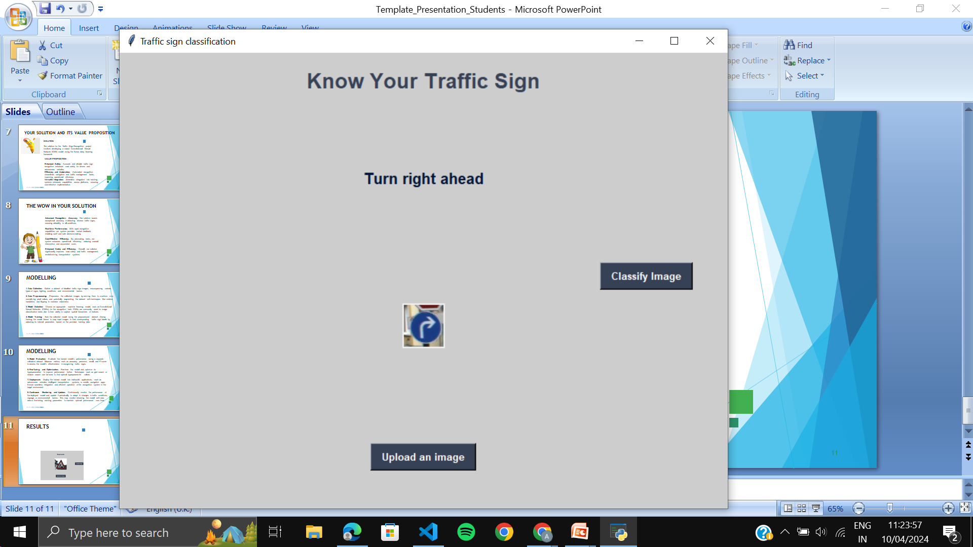
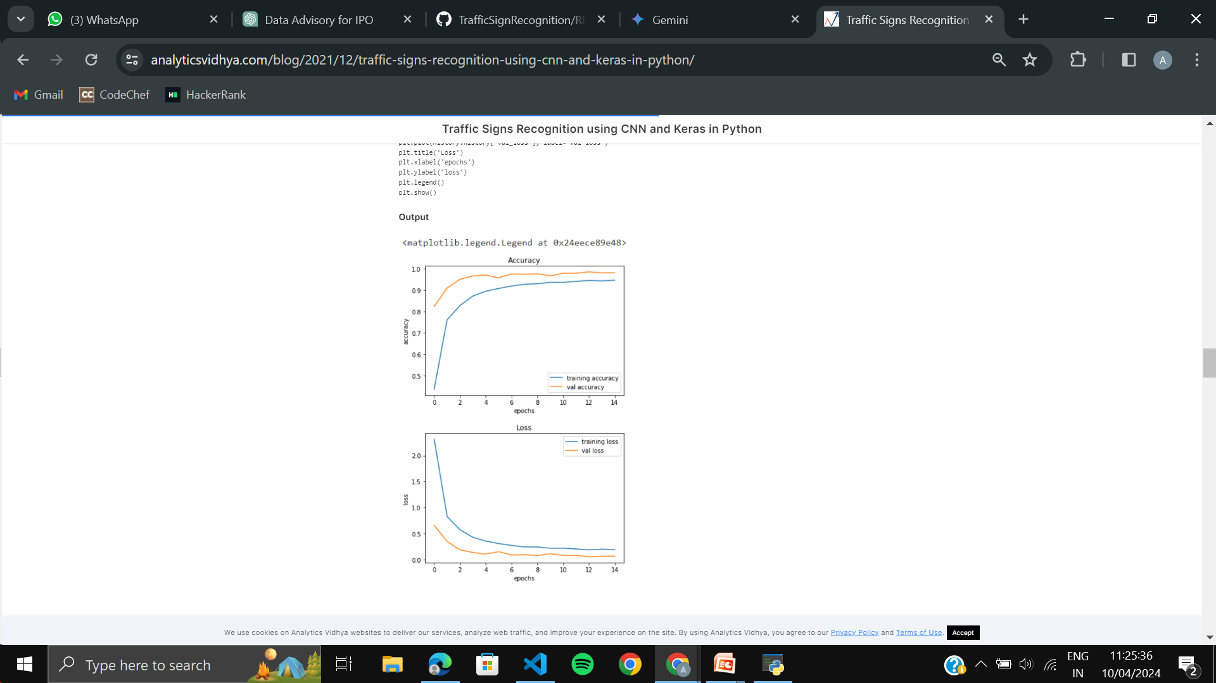
RESULTS

